Slide 1
Cardiovascular Disease Analysis
Coursera Capstone
By Chris Buys

Slide 2

Background & Problem Statement
Background:
Heart disease costs the United States approximately 219 billion dollars each year which includes the cost of health care services, medicines and lost of productivity due to death.
Problem:
If people with or without cardiovascular disease could be identified with a certain amount of certainty resources could be better planned for and the target group could be treated more effectively.

Slide 3

Methodology
Data Science Methodology applied iteratively to address the problem at hand
Data sourced and processed for outliers
Statistical analysis completed
Logistic regression model built to make predictions of cardiovascular disease
Model evaluation performed

Slide 4
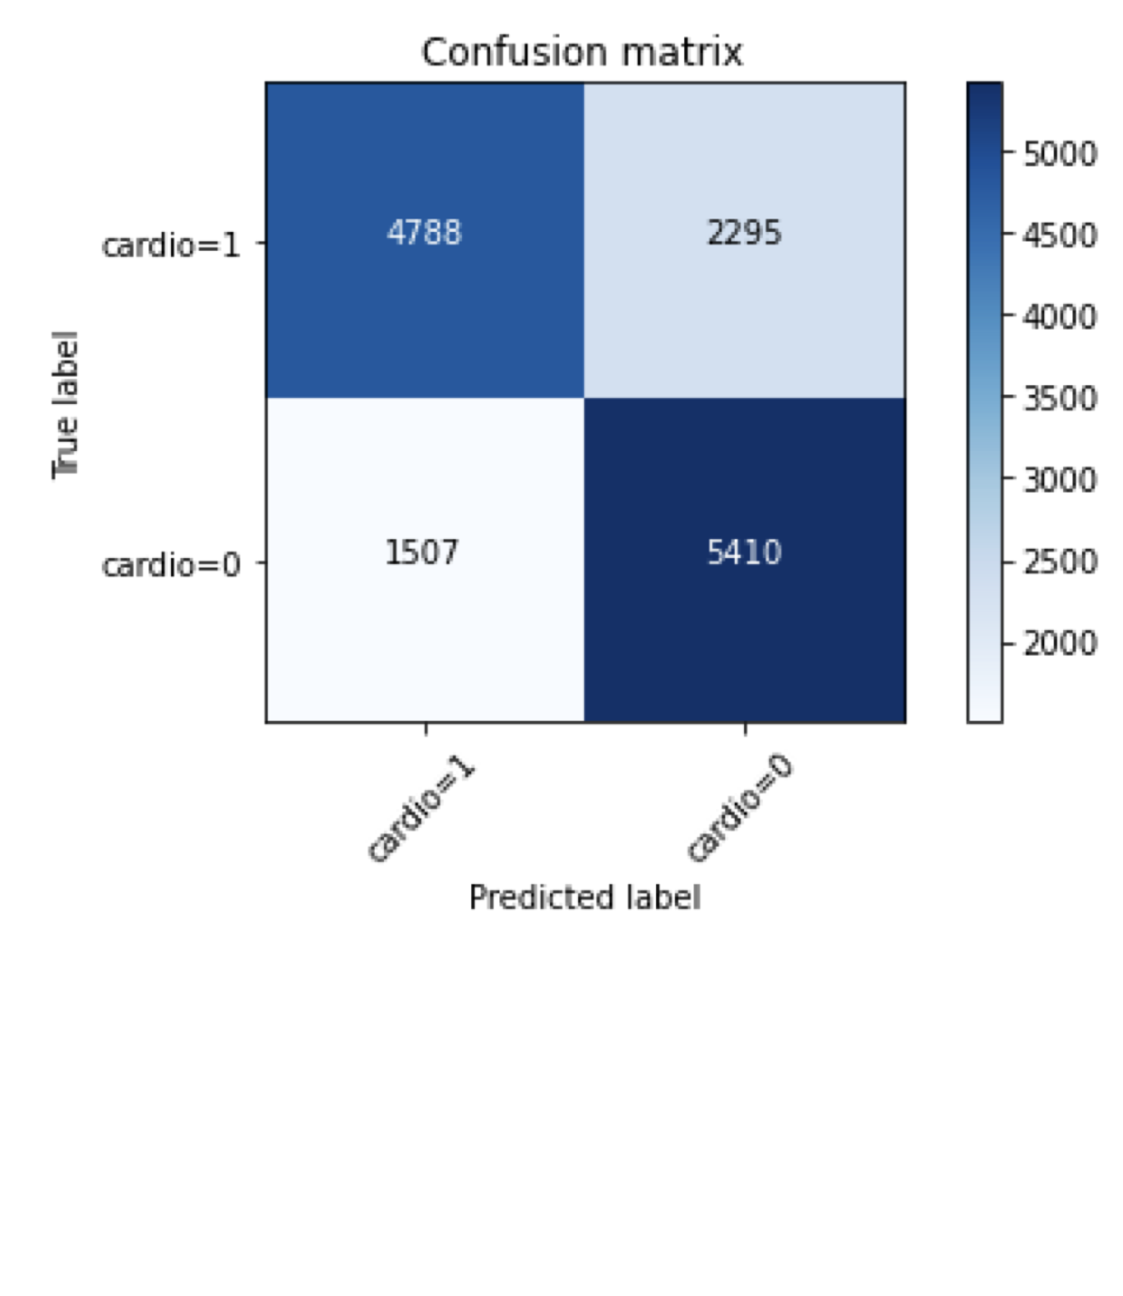
Results
The model built has a false positive percentage of is 23.94% where as the false negative percentage of 29.79%. The model produced an f-1 score of 73% while it was found that subjective information included to build a model doesn’t make better or worse predictions (there is no statistical difference with a p-value of 0.19).

Slide 5
Reflection
Various limitations including data sourcing and selection, time and resources, domain knowledge of data etc.
Model could be a good starting point for future work to help make a general inference on the average person in a population as to predict the resourced needed to treat the population for cardiovascular disease.
Other methods that could be tried are methods such as k-means, decision trees etc.
Is this feature set the most best to be used to make this kind of prediction. Correlation doesn’t mean causation and the data didn’t behave as expected meaning that the data set might not be representative of the population which in it self presents a challenge.
When dealing with a model where people’s lives could depend on you can’t settle for a low percentage outcome.

Slide 6
Thank You

